Slide 1
DAMG6210 DATA MANAGEMENT AND DATABASE DESIGN
RENTAL CAR MANAGEMENT SYSTEM
TEAM_ARSV
• AISHWARYA MISHRA – 002127206
• RUMI JHA - 002172213
• SANKET SANAP - 002136240
• VIGNESH KUMAR BASKAR - 002196442

Slide 2
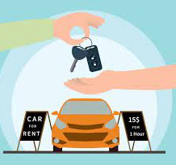
Contents:
Business Assumptions
ERD
Problem statement
Reports

Slide 3

BUSINESS ASSUMPTIONS:
Customer’s Data
Web application for bookings
All Cars insured
Fuel/Gas cost are covered
Different address types
Customer’s personal data like driver’s license and passport details are been verified
& many more….

Slide 4
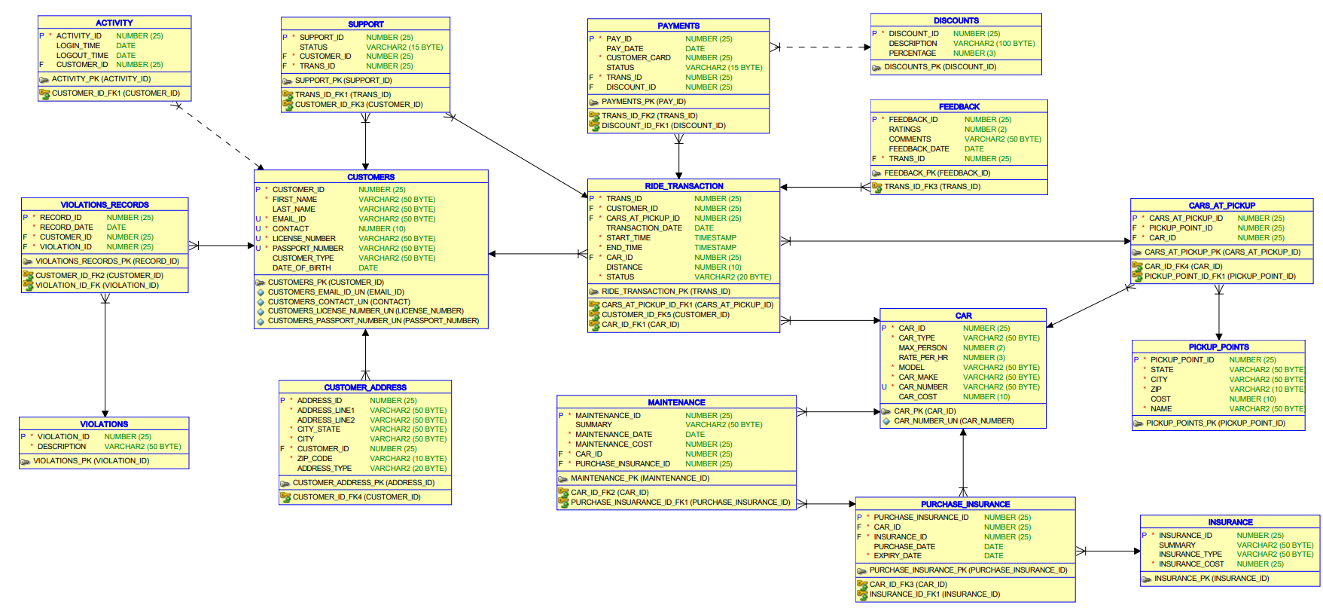
ERD

Slide 5

PROBLEM STATEMENT:
1. Most prevalently used car types based on the number of passengers travelled.
2. Analyzing booking transactions based upon the distance travelled with respect to the type of car.
3. Revenue generated per quarter based on the region/location.
4. Report based on the usage pattern of $/hr. w.r.t $/miles.
5.Improving services based on customer’s feedback report.
6. Find out users who have not used services for long time in order send them attractive deals or attract in any manner.

Slide 6

REPORTS

Slide 7
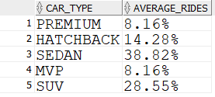
1.Prevalent Car Types Used
Purpose:
Identifying the most prevalent car models in order to make new car investments for scaling up the business.
Solution
From the Ride Transactions table, we took the average of data for the number of bookings with respect to car types.

Slide 8
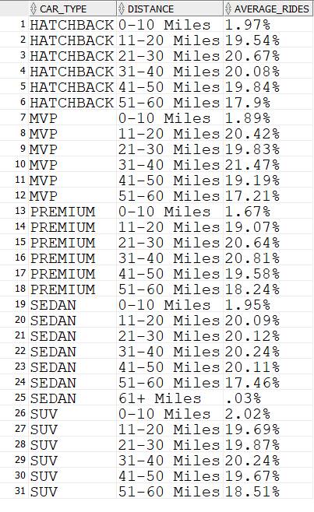
2.Car Bookings By Distance
Purpose:
Based on the customer car booking pattern, we are analyzing the data for the business team to make decisions on cost per mile between the range of distance travelled.
Solution:
From Ride Transactions table, we analyzed the data by type of cars which could be further categorized as distance travelled (Ex. 0-10, 11-20,21-30,31-40,41-50,51-60, miles ranges). Then we get the report of the usage patterns with respect to the type of cars. (Ex: Sedan, SUV, Hatchback, MVP, Premium )

Slide 9
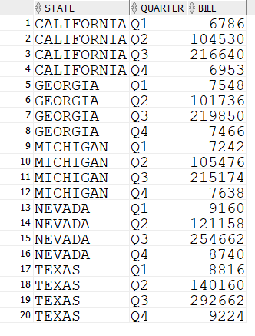
3.REVENUE GENERATED BY QUARTER 2021
Purpose:
For Analyzing how well the business works in all the regions and identify the best and the least performing regions.
Solution: From payments and transactions data, we will sum up the revenue based on the locations

Slide 10
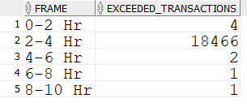
4.USAGE PATTERN
Purpose:
Identifying the customer usage pattern, by comparing the distance travelled with the predefined max distance for series of hours. If it exceeds the given distance, then the business team should re-think on their model in the aspect of $/miles than $/Hr.
Solution:
Based on the transaction and distance travelled data, we will generate a report on the distance travelled by customers who exceed the average distance per hour
TIME FRAME | MAX MILES
0-2Hr | 20
2-4Hr | 40
4-6Hr | 60
6-8Hr | 80
8-10Hr | 100

Slide 11
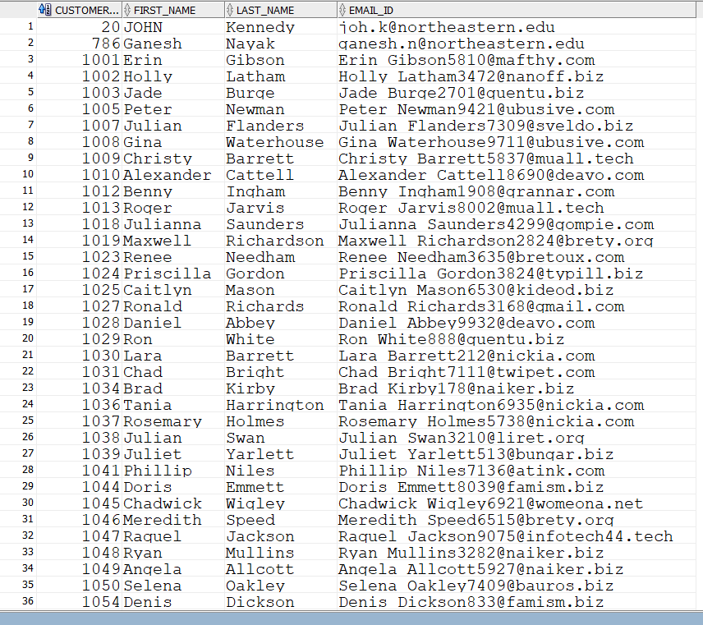
5.Inactive Customers
Purpose:
Analyzing the customers booking pattern, and to promote offers if any customer does not book a ride for more than 7 months.
Solution: Based on the ride transaction and customers data, we generated report of customers inactive for more than 7 months.

Slide 12
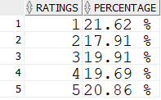
6.FEEDBACK REPORT
Purpose:
For enhancing the customer’s experience.
Solution:
Based on the feedback data, we generated the customers ride experience report for the business team.

Slide 13
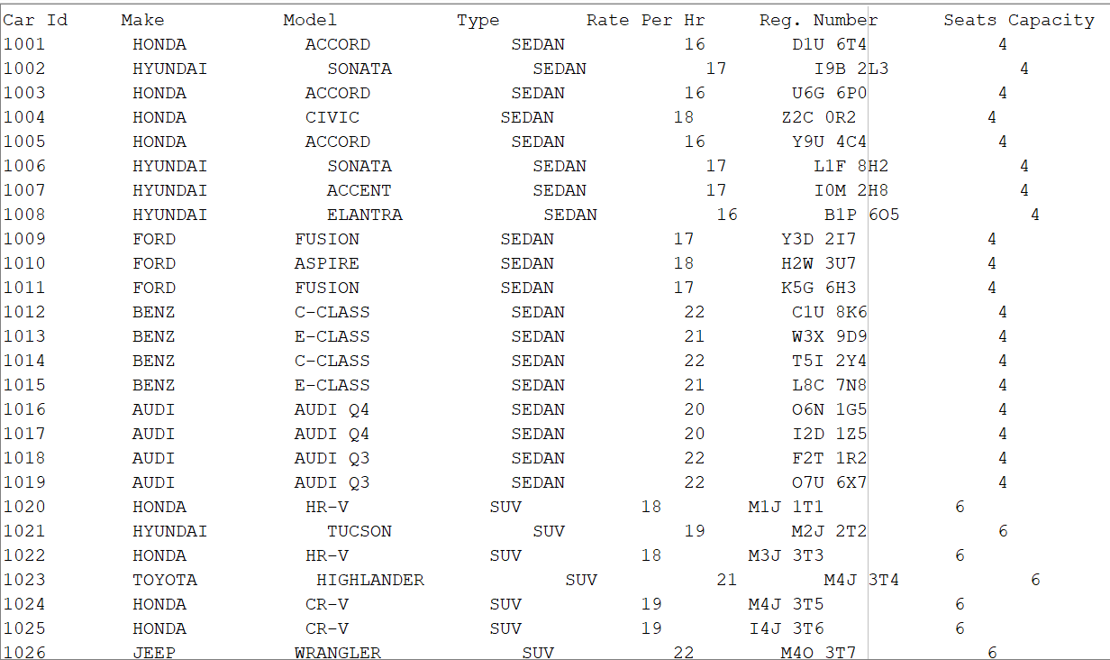
Show all available cars for given timeslot

Slide 14
Get car details for given car Id to book a ride

Slide 15
THANK YOU!

